Slide 1
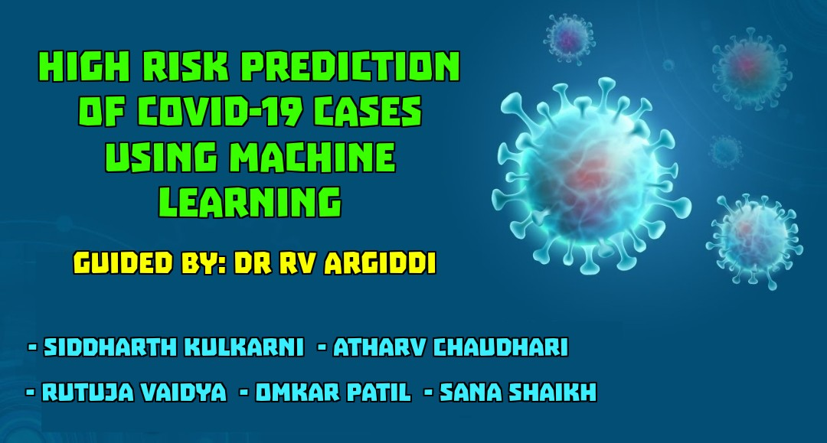

Slide 2
Idea of Project
This Study can help to check the Risk of Covid-19 patient by giving the Risk in terms of Probability.
It can be useful for Doctors to treat the patients with high Risk on a priority basis.

Slide 3
Background of Project
A paper named ‘Future Forecasting Using Supervised Machine Learning Models’ was published on May 2020. They found death rate, new infected cases rate and recovery rate.
The Result shows that:
New Infected cases are calculated with all 4 models with following R2 Values: LR: 0.83, LASSO: 0.98, SVM: 0.59, ES: 0.98. Recovery Rate is calculated with following R2 Values: LR: 0.39, LASSO: 0.29, SVM: 0.24, ES: 0.99.
A paper named “Machine Learning based approaches for detecting Covid-19 using Clinical Text Data”. was published on June 2020. They Found appropriate necessary attributes require for proper detection of Covid-19.
The Results shows that:
Logistic regression and multinomial Naïve Bayesian classifier give excellent results by having 94% precision, 96% recall, 95% f1 score and accuracy 96.2%.
We are aiming to find best technique/model to solve our problem & calculate the Probability of Risk.

Slide 4
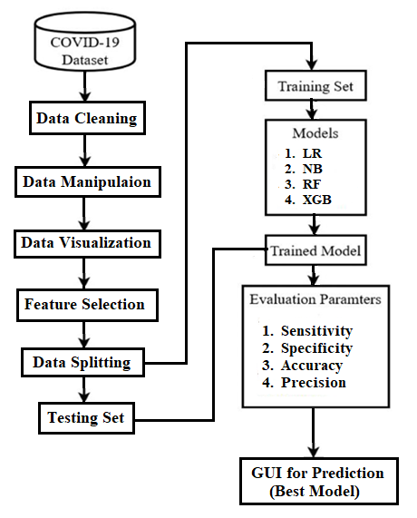
System Architecture

Slide 5
Methodology
Dataset: https://data.gov.il/dataset/covid-19/resource/d337959a-020a-4ed3-84f7-fca182292308
Features: Test Date, Symptoms (5), Test indication (3), gender, age_60_and_above.
Target Feature: Corona Result.
Data Preprocessing (Data Cleaning & Manipulation).
Data Visualization.
Feature Selection.
ML Algorithms: Logistic Regression, Naïve Bayes, Random Forest & Xgboost.
Evaluation Metrics for finding the Best Model.
Prediction on Best Model.

Slide 6




Technological Stack

Slide 7
Plan For Next 2 Months
Data Preprocessing, Visualization, Feature Selection & Data Modeling.
Finding most appropriate ML Algorithm for the Risk Prediction of COVID-19.
Risk Prediction in terms of Probability.
Designing WEB UI and connecting Model using Flask.

Slide 8
Work Distribution
Dataset Gathering: Sana Shaikh & Rutuja Vaidya.
Data Cleaning & Imputation: Siddharth Kulkarni.
Data Visualization & Manipulation: Rutuja Vaidya.
Feature Selection: Atharv Chaudhari.
Data Modeling: Sana Shaikh & Omkar Patil.
Connection With GUI: Atharv Chaudhari & Omkar Patil.
Testing: All 5 members.

Slide 9


